Slide 1
CIRCLE CI
PRESENTED BY KAVIN VELAVAN G

Slide 2
IntRODUCTION
Circle CI is a cloud-based CI/CD service that offers both SaaS (Software as a Service) and self-hosted options (Circle CI Server).
It operates in a containerized environment where each job runs in its isolated container or virtual machine.

Slide 3
FEATURES OF CIRCLE CI
Ease of Use: Circle CI is known for its user-friendly setup and configuration. The YAML-based configuration file is straightforward and easy to understand.
Speed: Circle CI offers pre-built Docker images, caching strategies, and parallelism, making build times faster, especially in cloud-based setups.

Slide 4
Integrated Environment: support for Docker, also integrates well with popular cloud providers and has built-in features like caching, parallel builds, and orbs (reusable packages).
Security: Circle CI's cloud offering manages infrastructure security, while the self-hosted version allows for more control over your environment.

Slide 5
REAL TIME EXAMPLES
Shopify uses Circle CI for its CI/CD pipeline to deploy updates to its e-commerce platform rapidly
Coinbase, a leading cryptocurrency exchange, uses Circle CI to manage its CI/CD pipelines, ensuring secure and efficient deployment of its applications

Slide 6
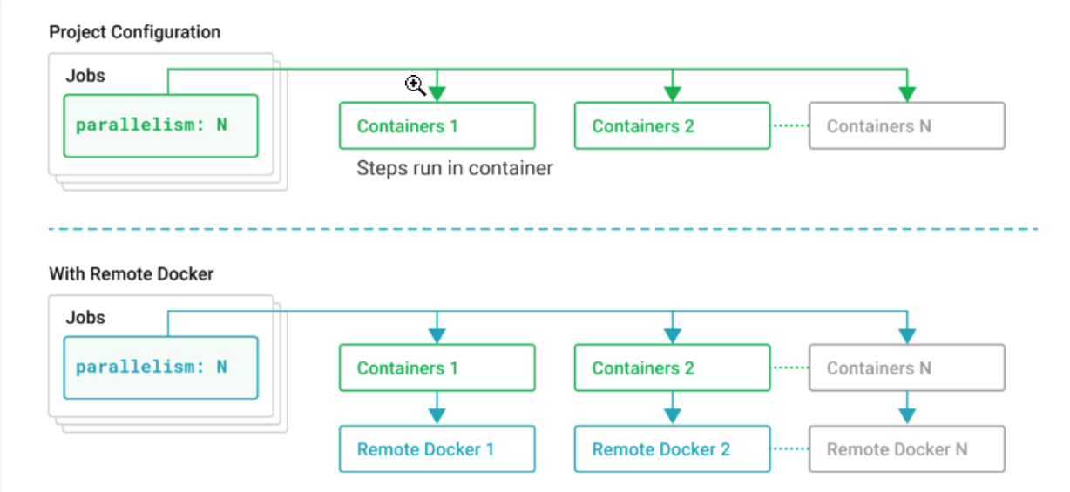
parallelism

Slide 7
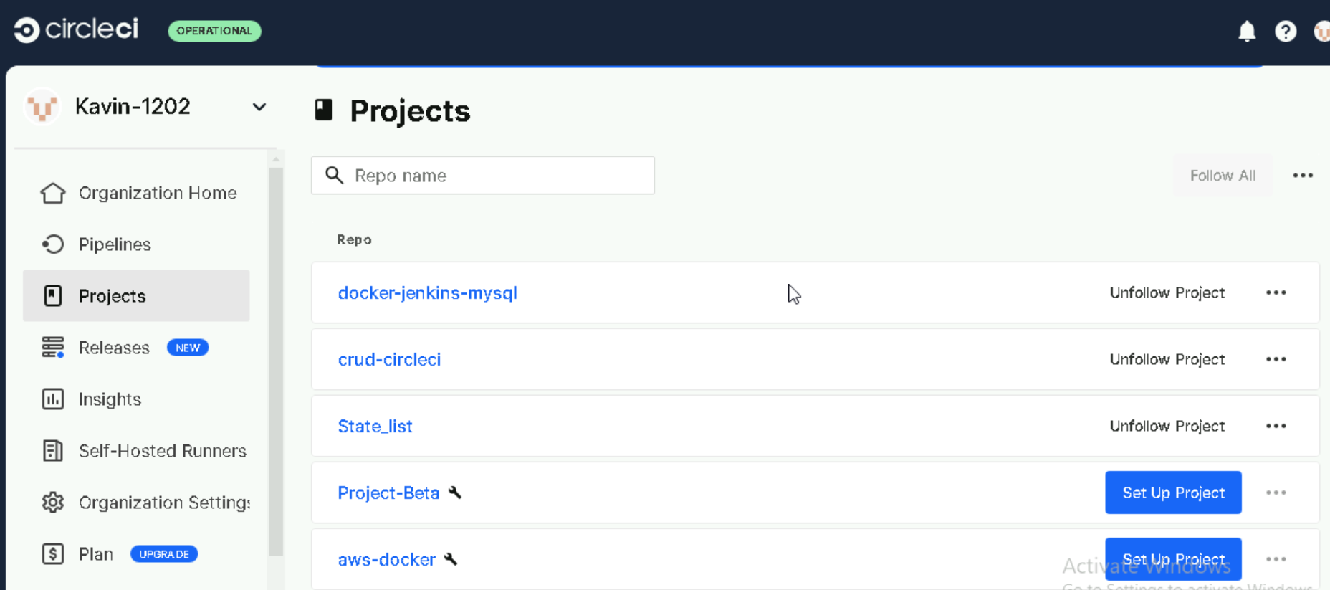
PROJECT CONNECTION TO CIRCLE CI

Slide 8
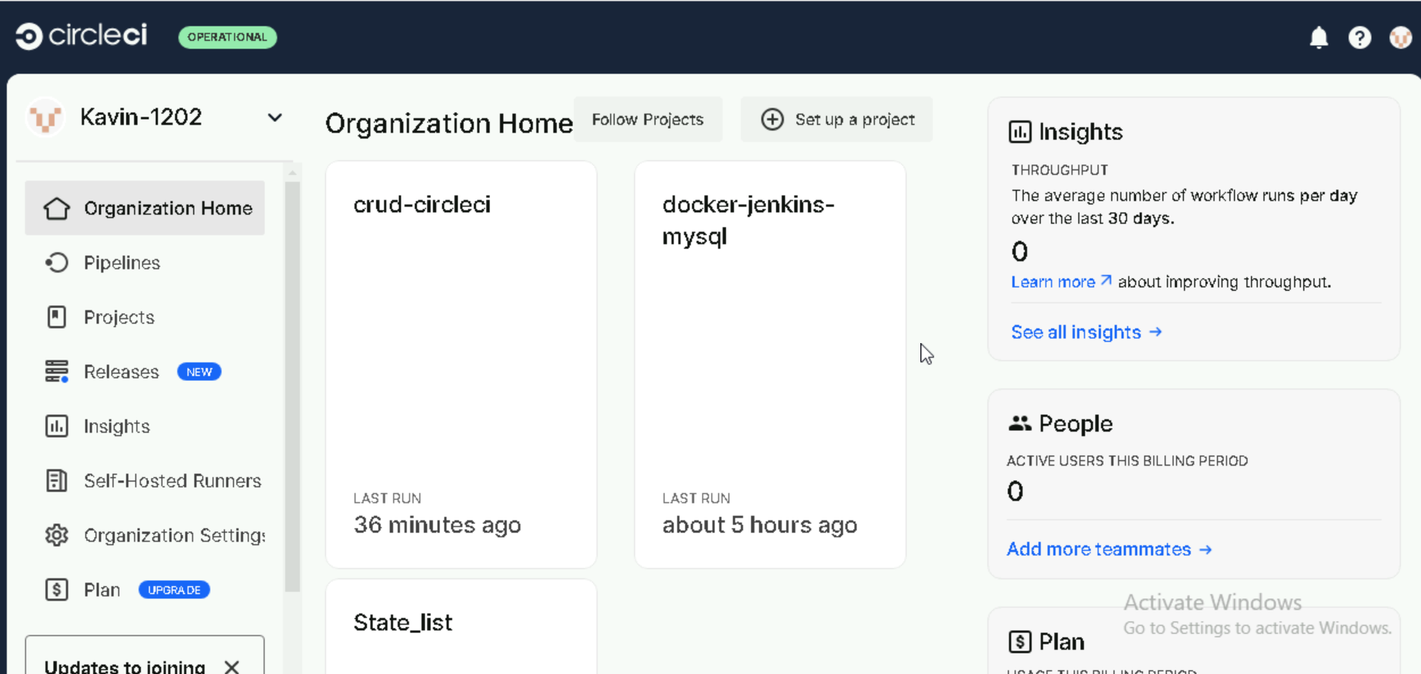
DASHBOARD

Slide 9
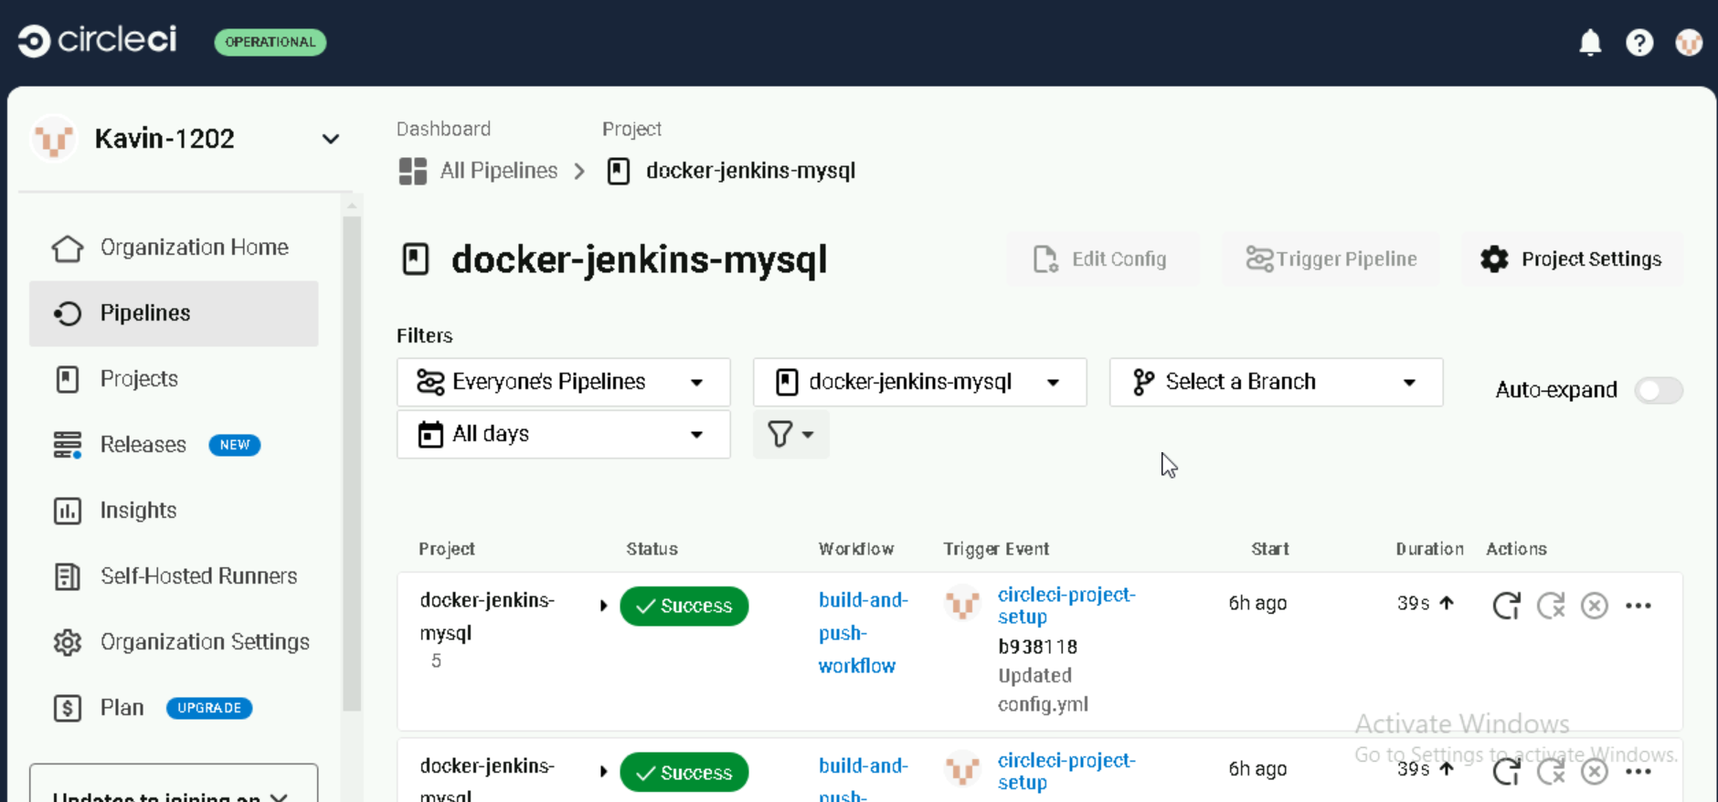
pIPELINES

Slide 10
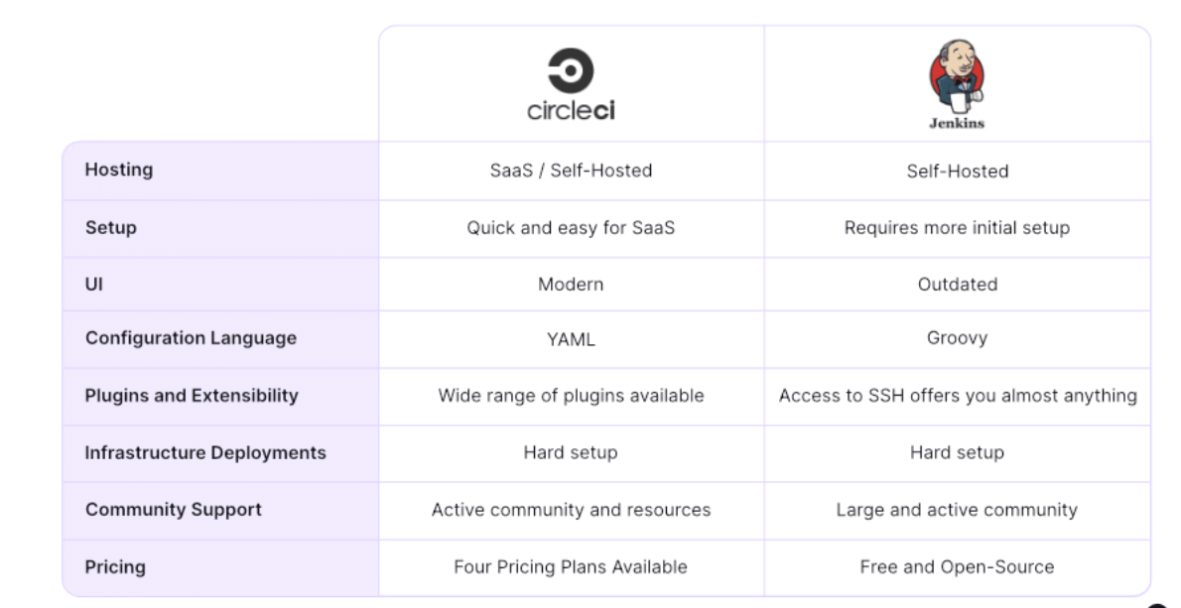
JENKINS VS CIRCLE CI

Slide 11
THANK YOU

